Slide 1
Drama is an exciting curriculum for all learners; enabling everyone to participate at their own level. It is not just about becoming an actor, it is designed to foster creativity, confidence and social skills such as interaction and communication. Drama at Idsall School provides a safe environment for students to explore or escape current life situations and experiences, whilst equipping them with knowledge and skills for life. Through practical activities, students will encounter and gain an appreciation of a variety of drama styles and practitioners and will consider the creative intentions of individual playwrights. Drama is an inclusive and yet challenging place to learn.
At the heart of our curriculum lie three Golden Threads:
Performance Skills
Key Social Skills
Themes and Issues

Slide 2
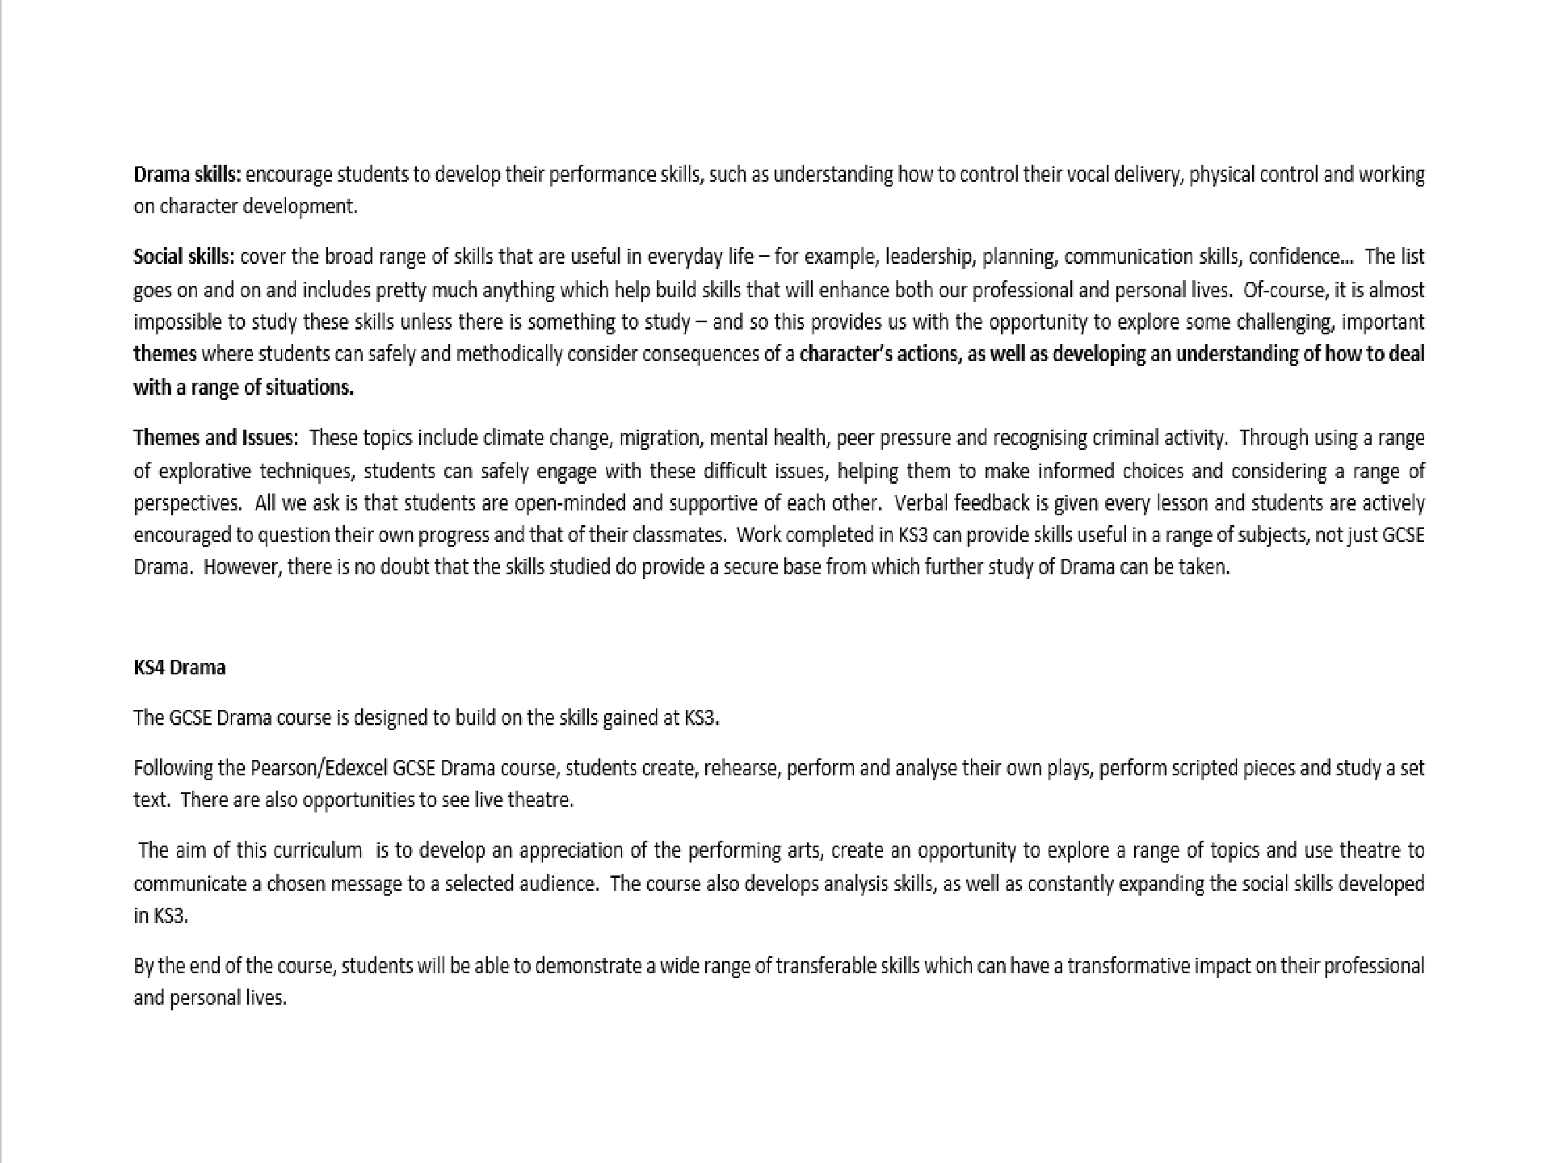

Slide 3
1. Amadorra
4000 years ago…An Island paradise…an ancient tribe. Journey back in time to see how the Amadorrians live and work together
3. Gresford
A close-knot community…A coal mine…And a manager who cannot be trusted…
in one of the most beautiful places in the world.
1. Jo
Meet Jo – just a normal, everyday student. However, not everything is as it may seem on the surface.
Key Stage
Year
Year
3
7
8
2. Rose Blanche
80 Years ago the world is a very differet place. Conflict is everywhere and not everyone knows the full story
2. The Haunted School
Strange goings on… a terrified Cartetaker… Teachers behaving badly…What is going on
3. The Arrival
Using a graphic novel as a stimulus, follow the
when the school is closed…?
1. Identity
Everyone has a secret. But some secrets are darker than others…
journey of a man as he looks fo a new life…
Key Stage 4
Year 10
Year
3. Cody and Quinn
Two friends from different backgrounds. Conflict is everywhere and not everyone knows the full story…
9
2. The Stones
It’s just a normal day. Boredom sets in. And a couple of mates just want to have a laugh…
3. Set Text – The Crucible
Component 3 - Bringing Texts to Life –
1. Devise a performance
1. Devise a performance
Mock Component 1 - Cover the creating and developing process, and analyse and evaluate this process. (AO1, AO4)
Component 1 - Cover the creating and Questions based on an extract from the developing process, and analyse and Set Text.
evaluate this process. (AO1, AO4)
2. Text Performance
Mock Component 2 - Apply theatrical skills to realise artistic intention in live performance.
Year
11
3. Set Text – The Crucible
Component 3 - Bringing Texts to Life – Questions
2. Text Performance
Component 2 - Mock Component 2 - Apply theatrical skills to realise artistic intention in live performance.
_{Progression in}based_{D}on a_{r}n e_{a}xtra_{m}ct fro_{a}m the Set Text.

Slide 4
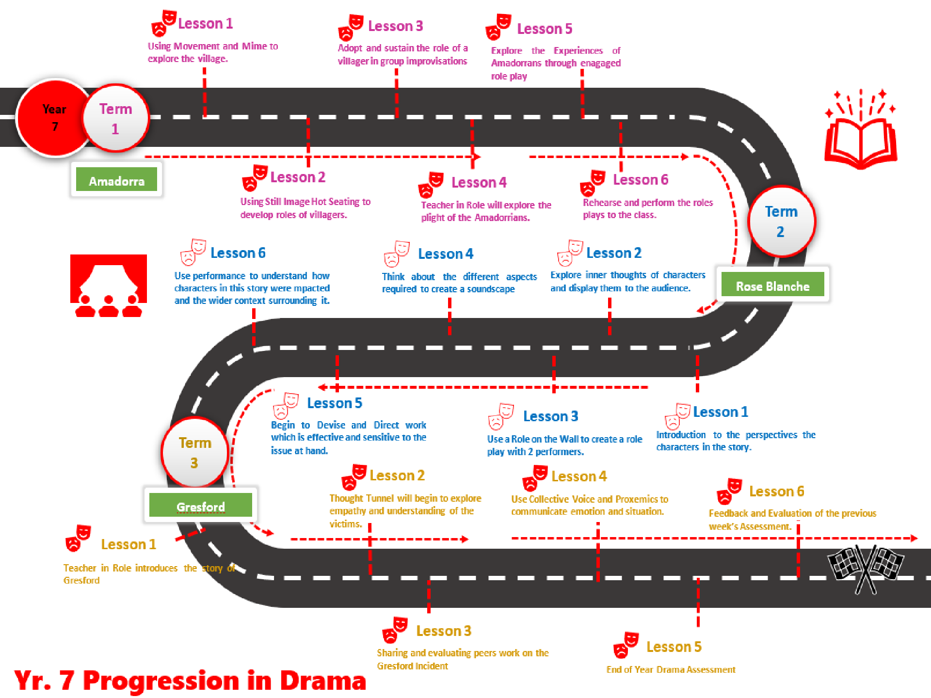

Slide 5
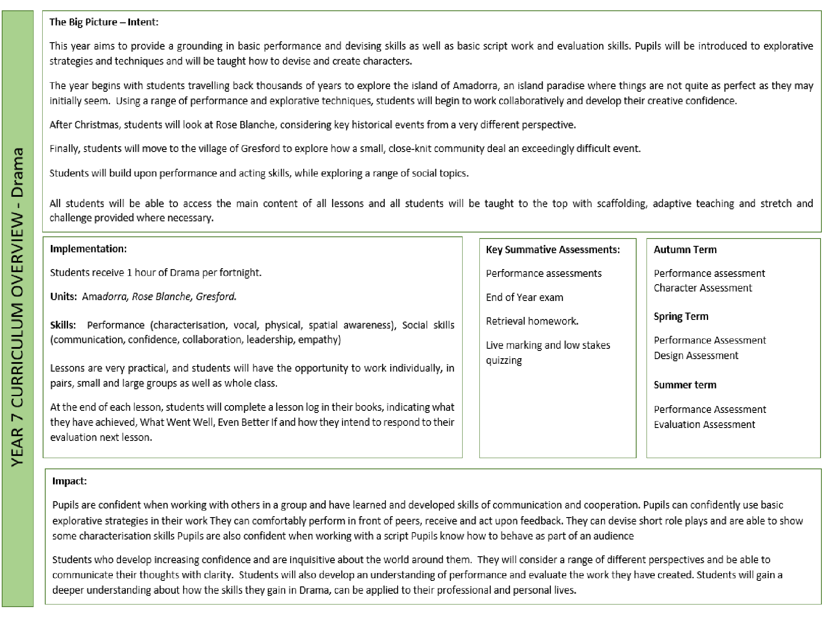

Slide 6
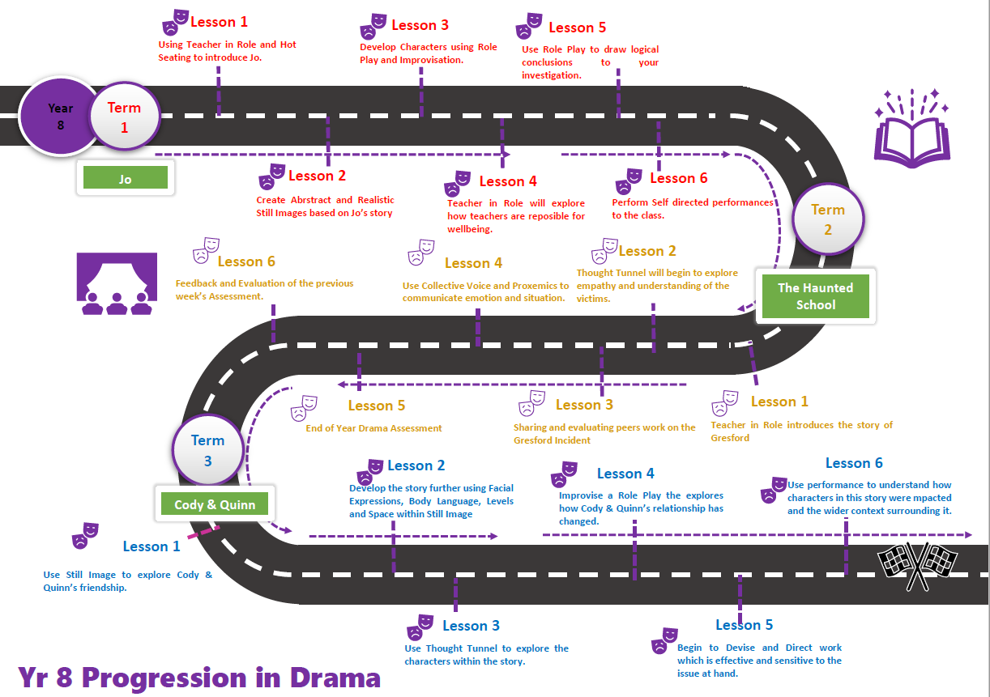

Slide 7
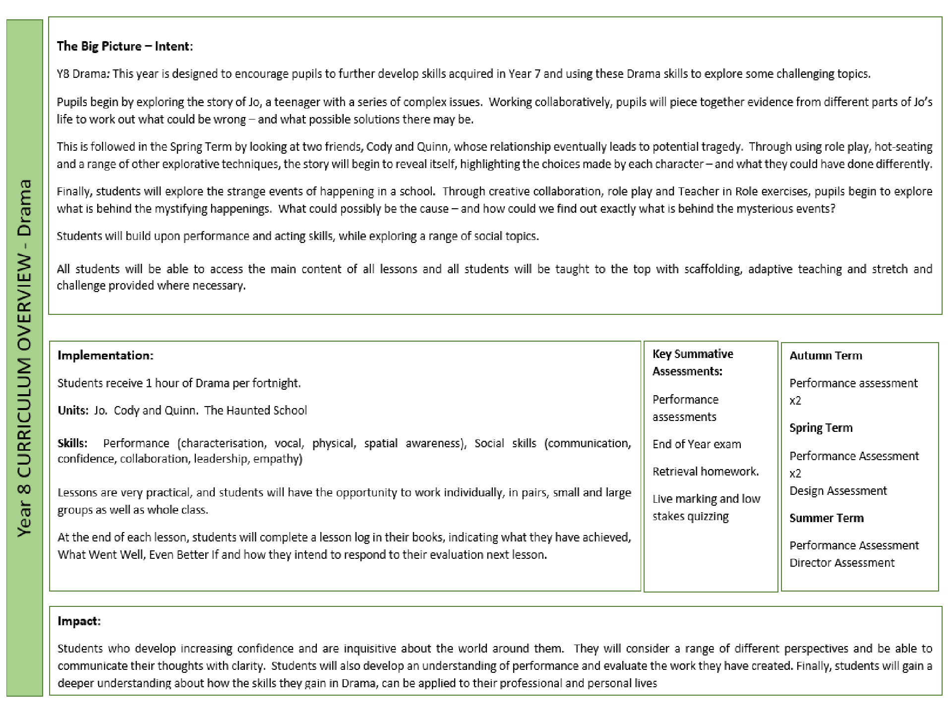

Slide 8
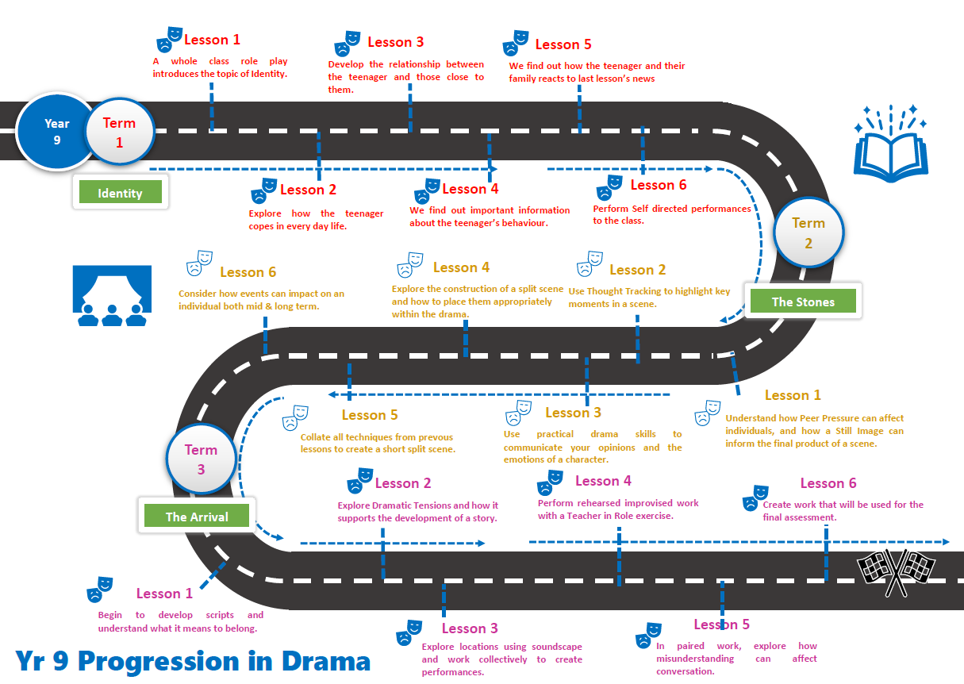

Slide 9
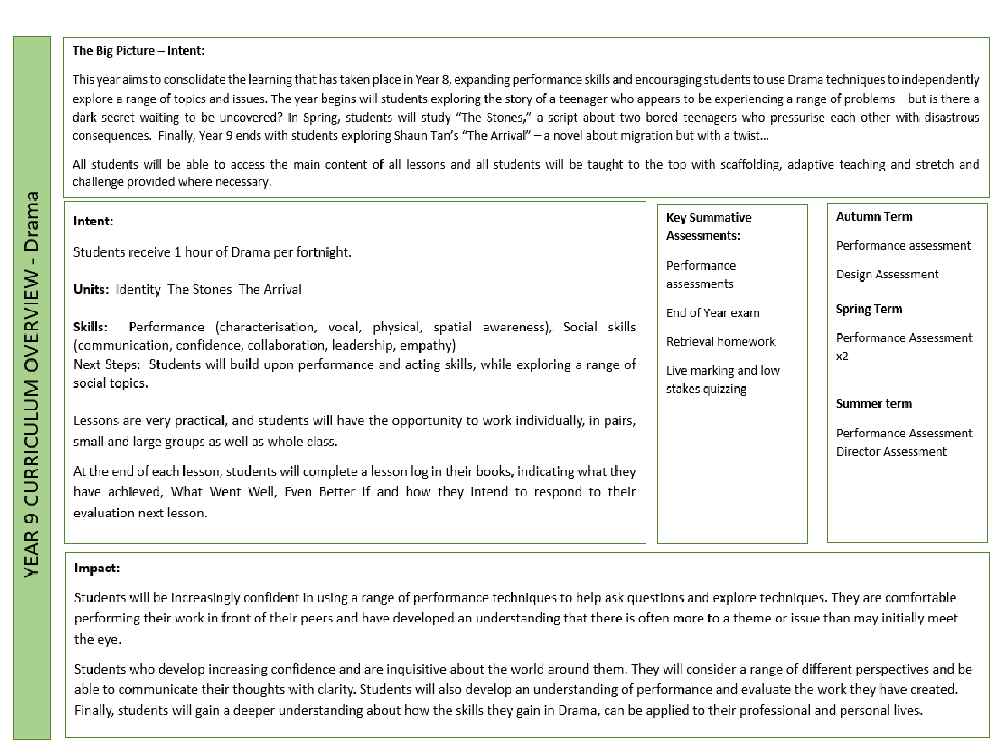

Slide 10
