Slide 1
IDSALL SCHOOL
Our vision for MFL:
The Department of Modern Foreign Languages is committed to providing a meaningful and enjoyable learning experience to all students.
We aim to encourage young people and parents to recognise the importance of language learning and the valuable cross-curricular skills that language learning brings. Language learning teaches students to become responsible and tolerant global citizens in an ever-increasing multi-cultural and inter-dependant world.
Language learning allows students to not only gain a functional skill, but also build on their literacy skills through discussing language in a meta-linguistic manner. Students are encouraged to become successful communicators by improving their ability to express their ideas in the target language through a focus on the three pillars of phonics, vocabulary, and grammar.
We celebrate success at all levels; we encourage those with a particular talent for languages to achieve the highest levels of attainment and we support those with additional learning needs to achieve realistic goals in language learning.
Language learning is not just about words. Students learn about other cultures and are encouraged to reflect on their own cultures and backgrounds, including language. The Modern Foreign Languages Department plays a key role in promoting positive attitudes to other languages and cultures, through sharing our personal, first-hand experience of living and working abroad.

Slide 2
Year 9 A Half Students – French beginners
The decision was made in the academic year 2022-23 to have all students study French. This decision was made to future proof the continued success of language learning at Idsall School.
Students in Year9 in the A year half are in the 2nd year of studying an ab initio French course. This accelerated French language scheme of learning covers all the basic vocabulary and grammar needed for success at KS4 as well as developing competencies in the key language modalities of Listening, Speaking, Reading, and Writing. The ab initio schemes of learning have a key emphasis on the three pillars of language acquisition – vocabulary, grammar, and phonics.
Students will study the following topics:
Year 9 (2024-25):
Unit 1 – the media
Unit 2 – technology
Unit 3 – healthy living
Unit 4 - Where I live / Dream house
These topics are the mode through which students will cover the following grammar:
Year 8 (2023-24) - Articles (definite and indefinite and possessive adjectives), Je m'appelle, J’ai, J’habite, Je suis, je parle, avoir and être, adjective agreement and position, ll y a, negatives, modal verbs (pouvoir and vouloir), opinion verbs + infinitives, comparative adjectives, quand phrases, jouer and faire + prepositions, aller, the near future tense, je voudrais and j’aimerais, the conditional tense, the perfect tense.
Year 9 (2024-2025) – opinions, direct object pronouns, opinions in the imperfect, adjective agreement and position, opinion verbs + infinitive, mieux que / pire que, impersonal structures, the pronoun en, partitive articles, quantities, the simple future tense, y, depuis, re verbs, prepositions, si clauses
The following sounds will be covered as part of the ab initio course:
ai, ais, au, ç, é, è, ê, ed, en, er, et, eu, ez, gn, I, ille, in, oi, on, ou, qu, tion, u, ui

Slide 3
Vocabulary: introducing yourself, physical descriptions, personality descriptions, , family, friends, pets, school, food and drink,
Where you live, directions
Grammar: definite and indefinite articles, je m’appelle, j’ai, j’habite, je suis, je parle, avoir and être, possessive adjectives, adjective agreement, past tense time frame, opinion verbs + infinitives, comparatives, partitive articles, negatives, modal verbs, je voudrais, il ya
Phonics: ai, ais, au, ç, é, è, ê, ed, en, er, et, eu, ez, gn, I, ille, in, oi, on, ou, qu, tion, u, ui
Year 7
Year 8
Unit 1 – Tout sur moi
Unit 2 – Mon monde perso
Unit 3 – L’école
Unit 4 – Boire et manger
Unit 5 – Mon quartier
Vocabulary: clothes, weather, free time, time, holidays: destinations, transport, activities, present, past, and dream holiday, sports and injuries, TV, music, film, reading
Grammar: possessive adjectives, adjective agreement and positions, quand, jouer and faire, near future tense, conditional tense, perfect tense, modal verbs, opinions, direct object pronouns, opinions in imperfect
Phonics: ai, ais, au, ç, é, è, ê, ed, en, er, et, eu, ez, gn, I, ille, in, oi, on, ou, qu, tion, u, ui
Year 8
Year 9
Unit 1 – ça c’est mon truc
,
Unit 2 – destinations vacances
Unit 3- bouger c’est important
Unit 4 – le monde des médias
Vocabulary: technology, social networks, family relationships, chores, pocket money, what life used to be like, food and drink, health resolutions, where you live, bedroom, dream home
Grammar: adjective agreement and position, opinion verbs+infinitives, mieux/pire que, impersonal structures, sequencers, modal verbs, imperative, imperfect tense, en, perfect tense, quantities, simple future, y, depuis, re verbs, prepositions, si clauses
Phonics: ai, ais, au, ç, é, è, ê, ed, en, er, et, eu, ez, gn, I, ille, in, oi, on, ou, qu, tion, u, ui
Year 9
KS4
Unit 1 – Accro à la technologie?
Unit 2 – être ado, c’est quoi?
Unit 3- En pleine forme
Unit 4- Chez moi ça veut dire quoi?

Slide 4
The Big Picture: Myself, Others, and My Immediate Surroundings Y7 French
Intent
Vocabulary: students will be able to recognise and use a range of vocabulary on the following topics | Grammar: students will be able to recognise and use the following grammar | Phonics: students will be able to recognise and produce the following sounds
introducing yourself, physical descriptions, personality descriptions, , family, friends, pets, school, food and drink, Where you live, directions | definite and indefinite articles, je m’appelle, j’ai, j’habite, je suis, je parle, avoir and être, possessive adjectives, adjective agreement, past tense time frame, opinion verbs + infinitives, comparatives, partitive articles, negatives, modal verbs, je voudrais, il y a | ai, ais, au, ç, é, è, ê, ed, en, er, et, eu, ez, gn, I, ille, in, oi, on, ou, qu, tion, u, ui
Summative Assessment
Students will have 2 summative assessments across the year.
Assessment 1: Listening, Speaking, Reading, Writing
Assessment 2: Listening, Speaking, Reading, Writing
Formative Assessment
Most assessment will be in the form of formative assessment
Students will have a formative writing task for each topic they complete.
Day to day teaching and learning may include the following formative assessment techniques in class
Student self-assessment in green pen
Verbal feedback
Use of mini whiteboards
Circulation
One to one feedback
Recasting of pronunciation errors
Directed questioning
Battleships
Reading aloud
Delayed writing
Listening bingo
Mind reader
RAG translations
Supported writing with sentence builders
Trap door speaking activities
Implementation:
Literacy will be developed through study of the main areas of communicative function (Listening, Reading, Writing, Speaking).
Students will also study translation and transcription
NCELP high frequency words and word families are the basis for the choice of units covered
Grammar is revisited in different contexts so is consolidated
Students will develop receptive skills, by developing their ability to recognise high frequency vocabulary in listening and reading
Students will develop productive skills by developing their ability to produce the covered high frequency vocabulary in conjunction with taught grammar in order to be able to express themselves with ever developing fluency
Scheme of Learning YEAR OVERVIEW
Impact:
By the end of year 7 students will be able to understand and answer questions about themselves and others including pets. Students will be able to give opinions on school, including subjects and teachers. Students will be able to give opinions on food and drink and know how to order in French speaking countries. Students will be able to describe where they live, what they can do there and ask for and give directions.
Notes:
UPDATED

Slide 5
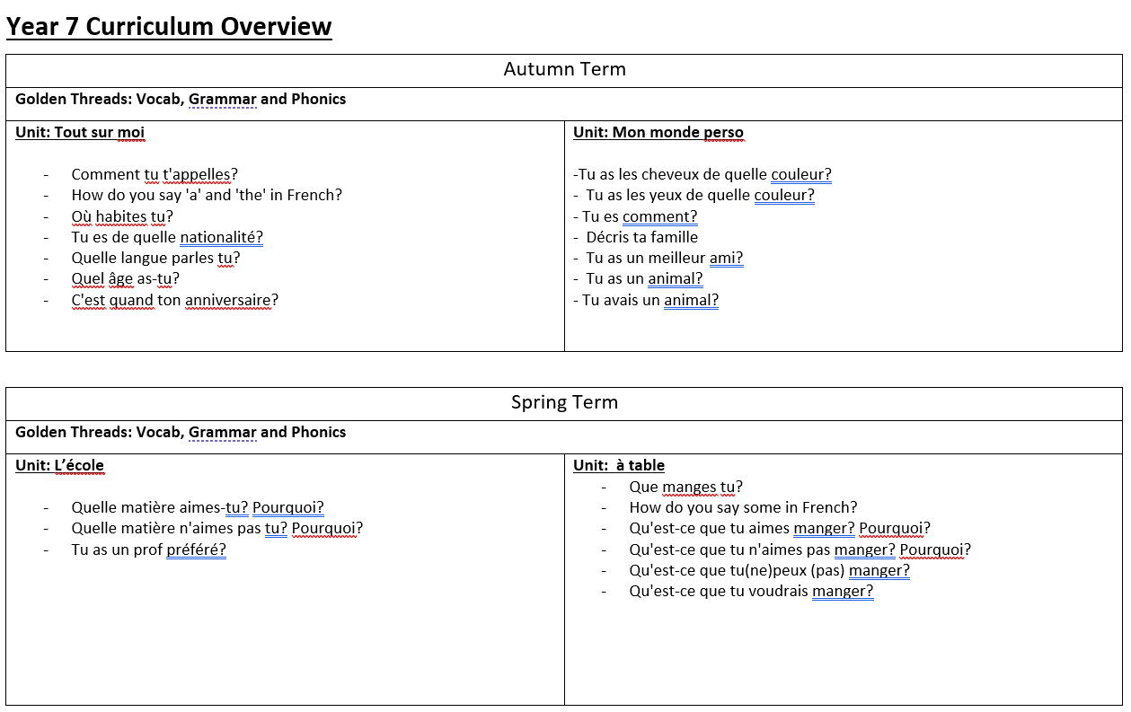

Slide 7
The Big Picture: Free time and Experiences Abroad Y8 French
Intent
Vocabulary: students will be able to recognise and use a range of vocabulary on the following topics | Grammar: students will be able to recognise and use the following grammar | Phonics: students will be able to recognise and produce the following sounds
clothes, weather, free time, time, holidays: destinations, transport, activities, present, past, and dream holiday, sports and injuries, TV, music, film, reading | possessive adjectives, adjective agreement and positions, quand, jouer and faire, near future tense, conditional tense, perfect tense, modal verbs, opinions, direct object pronouns, opinions in imperfect | ai, ais, au, ç, é, è, ê, ed, en, er, et, eu, ez, gn, I, ille, in, oi, on, ou, qu, tion, u, ui
Summative Assessment
Students will have 2 summative assessments across the year.
Assessment 1: Listening, Speaking, Reading, Writing
Assessment 2: Listening, Speaking, Reading, Writing
Formative Assessment
Most assessment will be in the form of formative assessment
Students will have a formative writing task for each topic they complete.
Day to day teaching and learning may include the following formative assessment techniques in class
Student self-assessment in green pen
Verbal feedback
Use of mini whiteboards
Circulation
One to one feedback
Recasting of pronunciation errors
Directed questioning
Battleships
Reading aloud
Delayed writing
Listening bingo
Mind reader
RAG translations
Supported writing with sentence builders
Trap door speaking activities
Implementation:
Literacy will be developed through study of the main areas of communicative function (Listening, Reading, Writing, Speaking).
Students will also study translation and transcription
NCELP high frequency words and word families are the basis for the choice of units covered
Grammar is revisited in different contexts so is consolidated
Students will develop receptive skills, by developing their ability to recognise high frequency vocabulary in listening and reading
Students will develop productive skills by developing their ability to produce the covered high frequency vocabulary in conjunction with taught grammar in order to be able to express themselves with ever developing fluency
Scheme of Learning YEAR OVERVIEW
Impact:
By the end of Year 8, students will be able to describe clothes and state what they wear, Students will be able to use weather phrases. Students will be able to state what they do in their free time, including sports, leisure activities, TV, music, films, and books. Students will be able to give opinions on their free time activities, and state when they do these activities using adverbs of frequency and times. Students will be able to make reference to 3 time frames and talk about life in French speaking countries.
Notes:
UPDATED

Slide 8
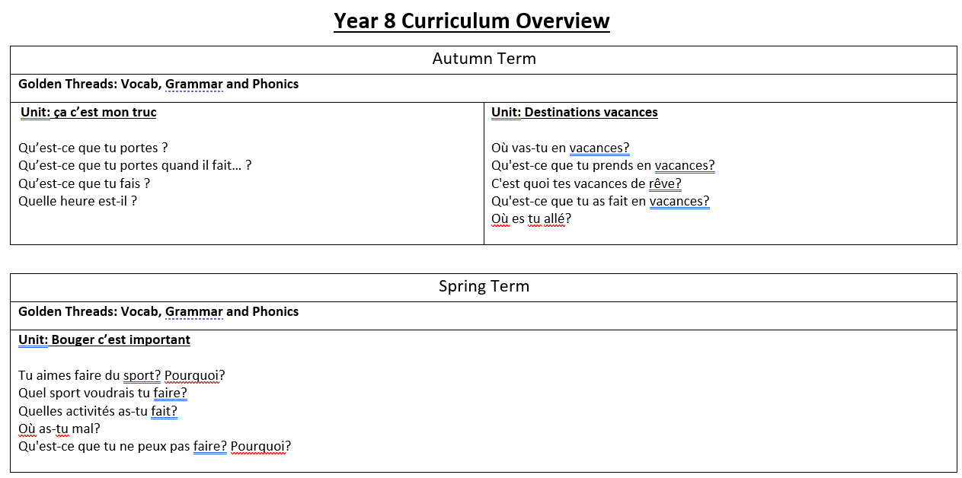

Slide 10
The Big Picture: Current, Past, and Future Life Y9 French
Intent
Vocabulary: students will be able to recognise and use a range of vocabulary on the following topics | Grammar: students will be able to recognise and use the following grammar | Phonics: students will be able to recognise and produce the following sounds
technology, social networks, family relationships, chores, pocket money, what life used to be like, food and drink, health resolutions, where you live, bedroom, dream home | possessive adjective agreement and position, opinion verbs+infinitives, mieux/pire que, impersonal structures, sequencers, modal verbs, imperative, imperfect tense, en, perfect tense, quantities, simple future, y, depuis, re verbs, prepositions, si clauses | ai, ais, au, ç, é, è, ê, ed, en, er, et, eu, ez, gn, I, ille, in, oi, on, ou, qu, tion, u, ui
Summative Assessment
Students will have 2 summative assessments across the year.
Assessment 1: Listening, Speaking, Reading, Writing
Assessment 2: Listening, Speaking, Reading, Writing
Formative Assessment
Most assessment will be in the form of formative assessment
Students will have a formative writing task for each topic they complete.
Day to day teaching and learning may include the following formative assessment techniques in class
Student self-assessment in green pen
Verbal feedback
Use of mini whiteboards
Circulation
One to one feedback
Recasting of pronunciation errors
Directed questioning
Battleships
Reading aloud
Delayed writing
Listening bingo
Mind reader
RAG translations
Supported writing with sentence builders
Trap door speaking activities
Implementation:
Literacy will be developed through study of the main areas of communicative function (Listening, Reading, Writing, Speaking).
Students will also study translation and transcription
NCELP high frequency words and word families are the basis for the choice of units covered
Grammar is revisited in different contexts so is consolidated
Students will develop receptive skills, by developing their ability to recognise high frequency vocabulary in listening and reading
Students will develop productive skills by developing their ability to produce the covered high frequency vocabulary in conjunction with taught grammar in order to be able to express themselves with ever developing fluency
Scheme of Learning YEAR OVERVIEW
Impact:
By the end of Year 9, students will be able to talk about technology, social media and new technologies. Students will be able to talk about values, relationship with family, pocket money, chores, and the pressures facing today’s youth. Students will be able to talk about healthy lifestyles, diet and resolutions. Students will be able to discuss where people live, including ideal homes. Students will be increasingly accurate in their reference to 3 time frames.
Notes:
UPDATED

Slide 11
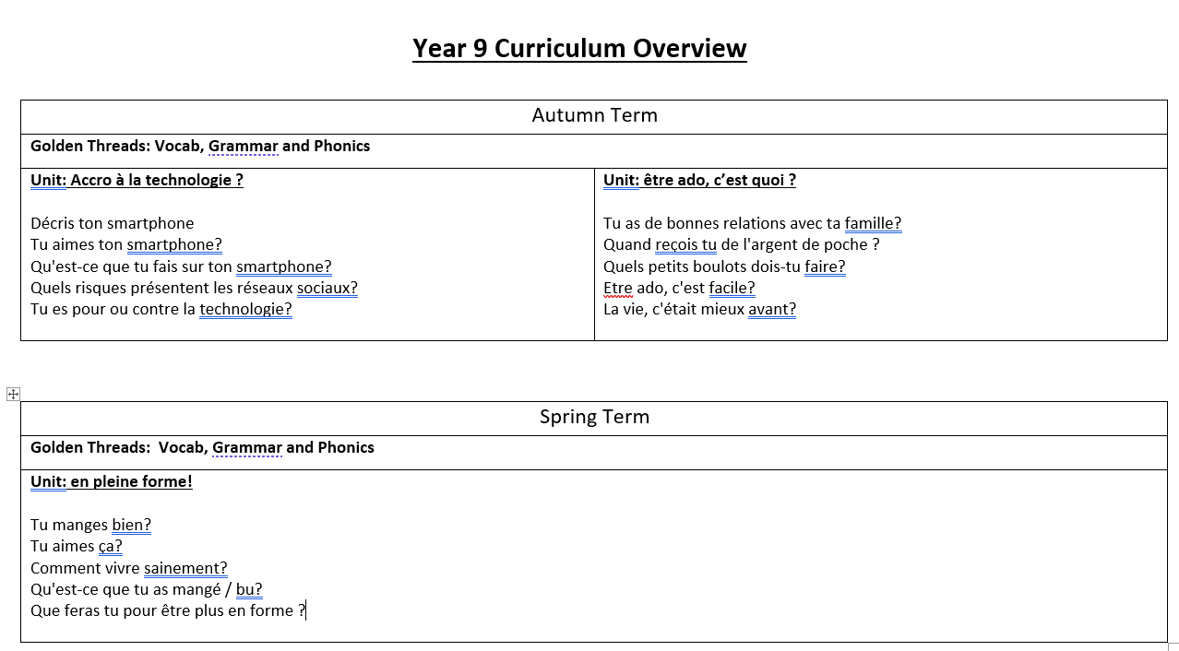

Slide 13
GCSE French – Year 10 and 11
Year 10 (2024-25) will study the AQA GCSE French course (8652). This is a new specification for first examination in summer 2026
Year 11 (2024-25) will study the AQA GCSE French course (8658). This is the legacy GCSE

Slide 14
The Big Picture: AQA GCSE FRENCH Themes 1,2,3 Y10 French
Intent:
AO1: understand and respond to spoken language in speaking and writing
AO2: understand and respond to written language in speaking and writing
AO3: demonstrate understanding and accurate application of the grammar and vocabulary prescribed in the specification
These assessment objectives are split across the 4 GCSE paper. Details can be found on the next slide
Summative Assessment
Students will have 3 summative assessments across the year.
Assessment 1: Listening, Speaking, Reading, Writing
Assessment 2: Listening, Speaking, Reading, Writing
Assessment3: Year 10 mock examination
Implementation:
Literacy will be developed through study of the main areas of communicative function (Listening, Reading, Writing, Speaking).
Vocabulary is revisited in similar contexts and grammar is revisited and consolidated
Students will develop receptive skills, by developing their ability to recognise high frequency vocabulary in listening and reading
Students will develop productive skills by developing their ability to produce the covered high frequency vocabulary in conjunction with taught grammar in order to be able to express themselves with ever developing fluency
Formative Assessment
Most assessment will be in the form of formative assessment
Students will have a formative writing task for each topic they complete.
Day to day teaching and learning may include the following formative assessment techniques in class
Student self-assessment in green pen
Verbal feedback
Use of mini whiteboards
Circulation
One to one feedback
Recasting of pronunciation errors
Directed questioning
Battleships
Reading aloud
Delayed writing
Listening bingo
Mind reader
RAG translations
Supported writing with sentence builders
Trap door speaking activities
Scheme of Learning YEAR OVERVIEW
Impact:
By the end of Year 10, students will have covered all 9 units of the AQA course. Students will be able to make reference to three time frames, express opinions, give justifications and use a range of connectives. Students will be able to recognise a range of topic vocabulary, as prescribed in the word lists, in reading and listening, as well as using this vocabulary in speaking and writing. Students will be able to respond to role play prompts, describe pictures, and answer conversation questions on all topics covered. Students will be able to answer 50 word and 90 word questions. Students will translate with increasing accuracy and be able to read aloud with increasingly accurate pronunciation
Notes:
UPDATED

Slide 15
The Big Picture: AQA GCSE FRENCH Themes 1,2,3 Y10 French
Intent continued
Listening and Understanding:
Understand and respond to spoken extracts comprising defined vocabulary and grammar for each tier
Dictation of short, spoken extracts
Speaking:
Speaking in clear and comprehensible language to undertake a role play
Carry out a reading aloud task
Talk about visual stimuli
Hold an unprepared conversation
Reading and Understanding
Understand and respond to written texts which focus predominantly on the vocabulary and grammar at each tier
Infer plausible meanings of single words when they are embedded in written sentences
Translate from French to English
Writing
Write text in the language in a lexically and grammatically accurate way in response to simple and familiar stimuli
Translate from English to French
Scheme of Learning YEAR OVERVIEW

Slide 16
Half Term 1
Half Term 2
Half Term 3
Half Term 4
Half Term 5
Describe physical appearance, where you live and likes and dislikes
Describe a person’s character and personality.
Describe relationships with family.
Refer to different types of families.
Give preferences for food and drink.
Refer to attitudes to fast food and cooking.
Describe lifestyle choices and habits.
Refer to physical and mental well-being.
Describe recent activities, including sporting activities, ways of keeping fit, and food choices.
Express opinions about school rules and uniform
Express opinions about school subjects.
Describe personal qualities.
Refer to education post-16: options available, advantages and disadvantages, future intentions, and plans.
Give opinions on different jobs, including advantages and disadvantages
Refer to ideal job, personal ambitions, and skills required.
Complete Assessments on theme 1 content
Refer to past activities including hobbies and sport
Describe leisure activities in the past.
Add details regarding when, where, and who with.
Refer to future plans for leisure activities.
Express opinions.
Refer to and give opinions on leisure activities around the world.
Refer to celebrations with family and friends such as birthdays.
Learn about local festivals in a French-speaking community.
Refer to and give opinions on festivals and celebrations with family and friends such as birthdays, religious events, and other special days.
Describe a recent festival with family or friends.
Refer to nationally renowned events such as music festivals.
Learn about national festivals in a French-speaking country.
Refer to different routes to fame, including music, film, TV, fashion, culture, and technology.
Give opinions on a variety of celebrities.
Understand tips for becoming famous.
Give personal details and describe the abilities and achievements of a variety of famous people.
Refer to articles involving celebrities and influencers, and their impact on young people and wider society.
Refer to the advantages and disadvantages of being famous.
Understand celebrity magazines / articles / podcasts involving famous people and influencers.
Complete an assessment on theme 2 content
Refer to and give opinions on holidays, holiday activities, and weather.
Describe places where we used to live.
Refer to places of interest and different locations including francophone islands across the world.
Refer to recent a holiday, including the destination, transport, activities, and accommodation.
Describe a recent holiday experience, including the destination, location, transport, weather, activities, and accommodation.
Refer to all kinds of media, such as the internet and social media, including how they are used and the frequency of use.
Refer to usual and recent uses of the internet, including social media and different apps and platforms.
Give reasons for personal use with advantages and disadvantages.
Give opinions of using mobile phones and different apps.
Refer to technology use in the past, present, and future, including frequency of use.
Refer to activities at a local level to help and protect the environment.
Refer to wider global issues causing environmental damage and describe future activities that would make a positive impact on the planet.
Describe your home and activities at home.
Describe your town / village / neighbourhood of residence, including local buildings, activities, and facilities.
Give opinions including advantages and disadvantages for young people and tourists.

Slide 17
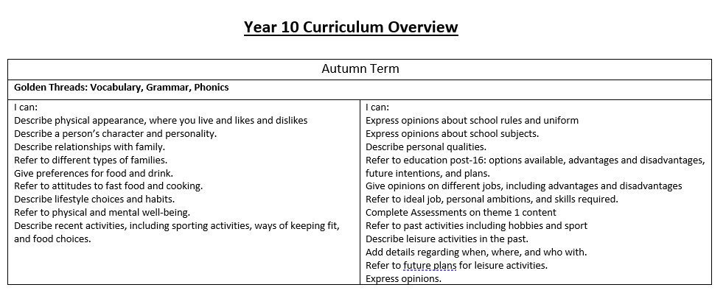

Slide 18
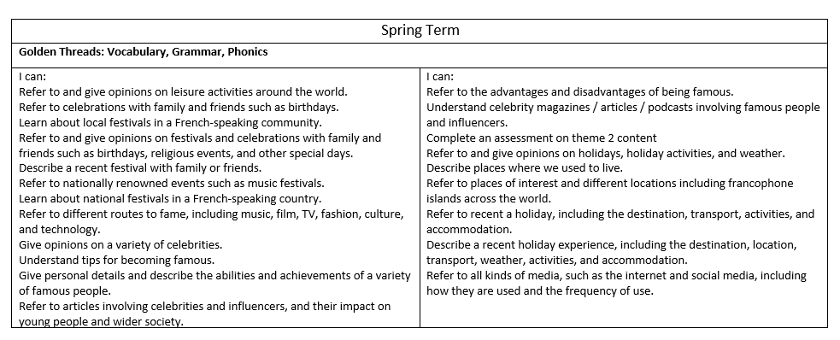

Slide 19
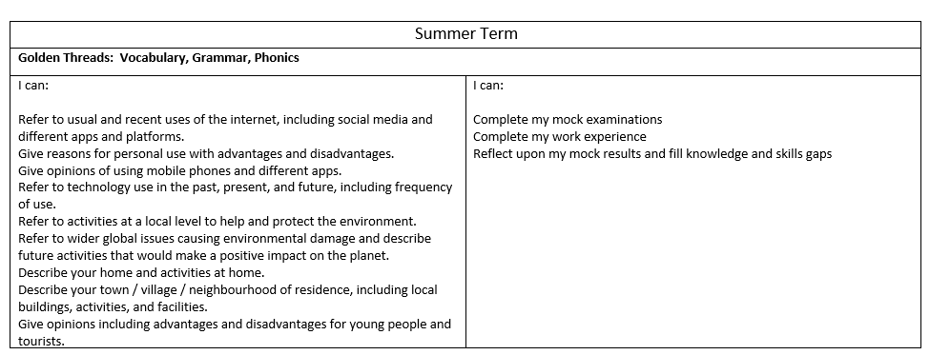

Slide 20
The Big Picture: AQA GCSE FRENCH Themes 1,2,3 Y11 French
Intent:
AO1: understand and respond to different types of spoken language
AO2: communicate and interact effectively in speech
AO3: understand and respond to different types of written language
AO4: communicate in writing
These assessment objectives are split into specific sub areas. Please see full break down on next slide
Summative Assessment
Students will have 3 summative assessments across the year.
Assessment 1: Mock examination series 1
Assessment 2: Mock examination series 2
Assessment 3: GCSE examinations
Implementation:
Literacy will be developed through study of the main areas of communicative function (Listening, Reading, Writing, Speaking).
Vocabulary is revisited in similar contexts and grammar is revisited and consolidated
Students will develop receptive skills, by developing their ability to recognise high frequency vocabulary in listening and reading
Students will develop productive skills by developing their ability to produce the covered high frequency vocabulary in conjunction with taught grammar in order to be able to express themselves with ever developing fluency
Formative Assessment
Students will have 5 formative writing tasks across the year.
Students will complete summative listening and reading tasks each half term
In addition to the formative writing tasks teachers will employ a range of formative assessment technique in class e.g.
Student self-assessment in green pen
Verbal feedback
Use of mini whiteboards
Circulation
One to one feedback
Recasting of pronunciation errors
Directed questioning
Scheme of Learning YEAR OVERVIEW
Impact:
By the end of Year 11, students will have covered all 12 units of the AQA course thorough a spiral curriculum in greater depth. Foundation students will be able to make reference to three time frames, express opinions, give justifications and use a range of connectives. Higher students will have covered a range of common and complex tenses. All students will be able to recognise a range of topic vocabulary in reading and listening, as well as using this vocabulary in speaking and writing. All students will be able to respond to role play prompts, describe pictures, and answer general conversation questions on all topics covered. Foundation students will be able to answer 40 word and 90 word questions and Higher students will be able to respond to 90 word and 150 word questions. All students will translate with increasing accuracy
Notes:
UPDATED

Slide 21
The Big Picture: AQA GCSE FRENCH Themes 1,2,3 Y11 French
Intent continued
Listening and Understanding:
demonstrate general and specific understanding of different types of spoken language
follow and understand clear standard speech using familiar language across a range of specified contexts
identify the overall message, key points, details and opinions in a variety of short and longer spoken passages, involving some more complex language, recognising the relationship between past, present and future events
deduce meaning from a variety of short and longer spoken texts, involving some complex language and more abstract material, including short narratives and authentic material addressing a wide range of relevant contemporary and cultural themes
recognise and respond to key information, important themes and ideas in more extended spoken text, including authentic sources, adapted and abridged, as appropriate, by being able to answer questions, extract information, evaluate and draw conclusions.
Speaking:
communicate and interact effectively in speech for a variety of purposes across a range of specified contexts
take part in a short conversation, asking and answering questions, and exchanging opinions
convey information and narrate events coherently and confidently, using and adapting language for new purposes
speak spontaneously, responding to unexpected questions, points of view or situations, sustaining communication by using rephrasing or repair strategies, as appropriate
initiate and develop conversations and discussion, producing extended sequences of speech
make appropriate and accurate use of a variety of vocabulary and grammatical structures, including some more complex forms, with reference to past, present and future events
make creative and more complex use of the language, as appropriate, to express and justify their own thoughts and points of view
use accurate pronunciation and intonation such as to be understood by a native speaker.
Reading and Understanding
understand and respond to different types of written language
understand general and specific details within texts using high frequency familiar language across a range of contexts
identify the overall message, key points, details and opinions in a variety of short and longer written passages, involving some more complex language, recognising the relationship between past, present and future events
deduce meaning from a variety of short and longer written texts from a range of specified contexts, including authentic sources involving some complex language and unfamiliar material, as well as short narratives and authentic material addressing a wide range of relevant contemporary and cultural themes
recognise and respond to key information, important themes and ideas in more extended written text and authentic sources, including some extracts from relevant abridged or adapted literary texts
demonstrate understanding by being able to scan for particular information, organise and present relevant details, draw inferences in context and recognise implicit meaning where appropriate
translate a short passage from French into English
Writing
communicate effectively in writing for a variety of purposes across a range of specified contexts
write short texts, using simple sentences and familiar language accurately to convey meaning and exchange information
produce clear and coherent text of extended length to present facts and express ideas and opinions appropriately for different purposes and in different settings
make accurate use of a variety of vocabulary and grammatical structures, including some more complex forms, to describe and narrate with reference to past, present and future events
manipulate the language, using and adapting a variety of structures and vocabulary with increasing accuracy and fluency for new purposes, including using appropriate style and register
make independent, creative and more complex use of the language, as appropriate, to note down key points, express and justify individual thoughts and points of view, in order to interest, inform or convince
translate sentences and short texts from English into French to convey key messages accurately and to apply grammatical knowledge of language and structures in context.
Scheme of Learning YEAR OVERVIEW

Slide 22
Half Term 1
Half Term 2
Half Term 3
Half Term 4
Half Term 5
Half Term 6
I can discuss how I use technology, how often and the benefits and dangers
I can state whether I use social networks and give reasons why I use them
I can state whether I am for or against traditional festivals and state why
I can discuss festivals and traditions in the past and future tense
I can state how I normally celebrate certain celebrations
Mock examinations series 2: Listening, Speaking, Reading, Writing
I can describe the differences between British and French schools
I can state what I have eaten and give opinions
I can state the advantages and disadvantages of technology
I can discuss world cuisines
GCSE examinations, study leave
I can state what I like / don’t like to eat
I can discuss future holidays
I can state where I want to visit in France
I can state what lessons I like / dislike and state why
I can discuss what I will do at the weekend
I can state whether I will do an apprenticeship and state why
I can state whether I will do a year abroad and state why
I can state my favourite subject
I can discuss past holidays, including issues faced, the weather, what I did, how I travelled
Targeted revision based on QLA and needs of class
I can describe my region and state what there is for young people
I can describe my school
I can discuss how to improve my school
I can discuss what I did at the weekend and give opinions
I can state whether I want to continue my studies
I can state what I will do if I succeed in my exams
I can state opinions on where I live and what there is to do where I live
I can discuss usual holidays
I can state my referred holiday
I can describe my dream house
I can discuss school rules
I describe school uniform
I can state what I think is the worst social issue
I can state what I want to do in the future
Targeted revision: Theme 3
I can state what job I want
I can state the advantages and disadvantages of jobs
I can state whether I want children
I can describe where I live and what is in my house
I can discuss whether I am / used to be in good health
I can discuss what I will do to be in good health
I can give opinions on unemployment
I can give opinions on homelessness
Targeted revision: Theme 2
I can state my weaknesses
I can state what I would like to do in 5 years
GCSE examinations, study leave
I can state whether I want to marry and why
I can argue whether marriage is a good idea
Mock examinations series 1: Listening, Speaking, Reading, Writing
I can discuss how to save the planet
I can give opinions on poverty
I can discuss what I ate and did at festivals
I can how to get a job and the qualities needed
Targeted revision: Theme 1
I can describe the qualities of a good friend
I can describe a partner
I can discuss how to make a difference in the community
I can discuss why we need charities
I can state environmental issues
I can state the biggest problems for the planet
Theme 1
Theme 2
Theme 3
I can discuss what festival I visited, where it was and when it was
I can state how I got to a festival and with whom I travelled
Preparation for GCSE Speaking Exams
I can describe my family and state whether we get on
I can describe a best friend and say if we get on
I can discuss sport- where and opinion
I can state why I do sport

Slide 23
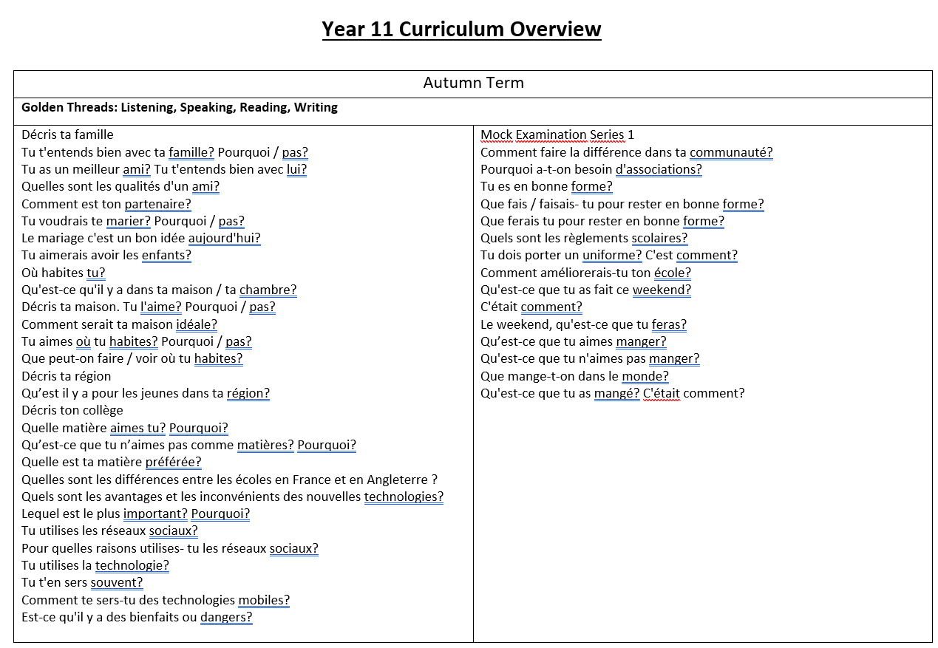

Slide 24
