Slide 1
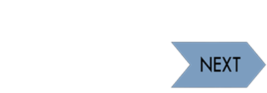
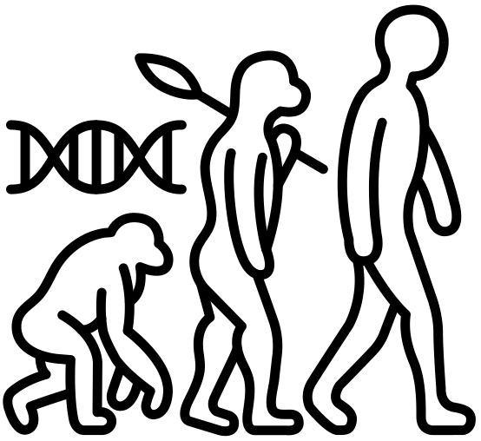
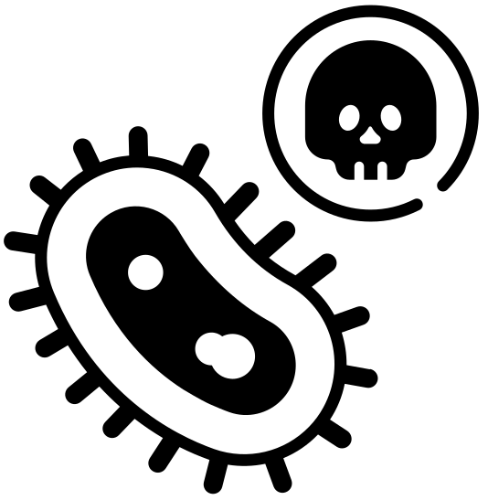
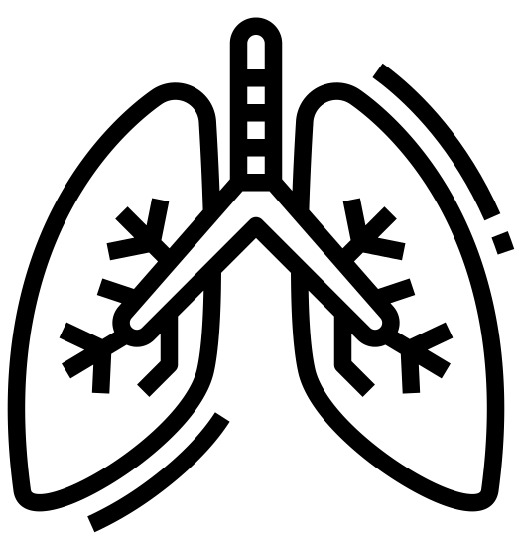
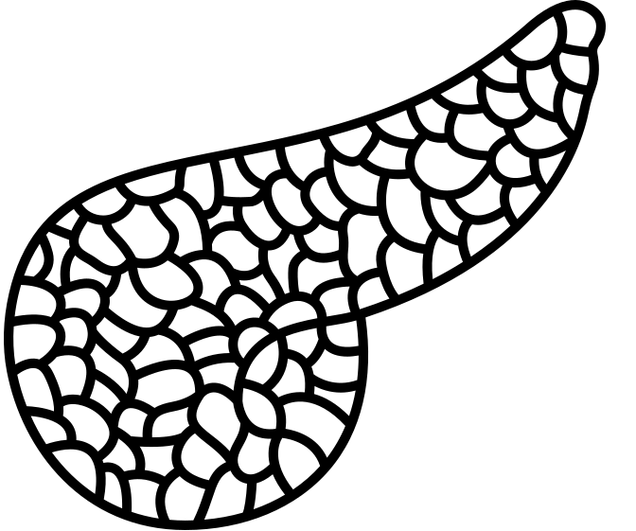
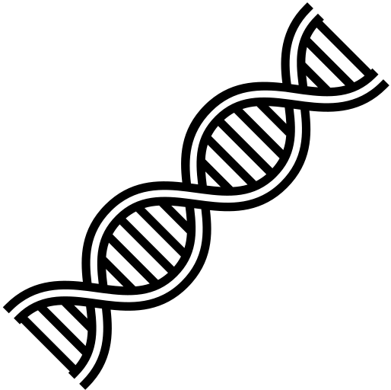
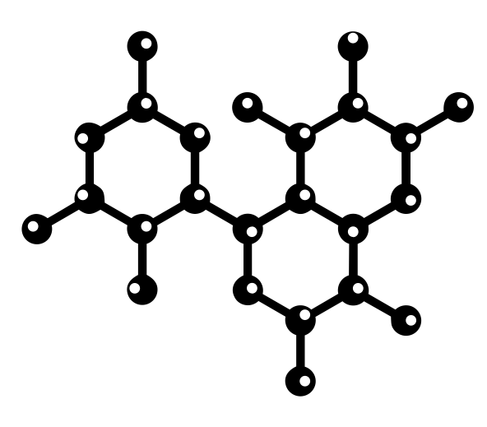
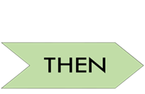
Idsall School
Year 12 A Level Biology Learning Journey
This way to Year 13
Exam Preparation
Build a portfolio of revision material, to help remember content covered and commit key information to long term memory. Make sure you are confident on the content covered this year, so you are ready to build upon this in Year 13.
Preparation for Next Year
4.2.1 Biodiversity - Biodiversity refers to the variety and complexity of life. It is an important indicator in the study of habitats. Maintaining biodiversity is important for many reasons. Actions to maintain biodiversity must be taken at local, national and global levels.
YEAR 12 EXAMS
EXAM; 4.2.1 Biodiversity
Summer Term 2
Exam Preparation
Revise over content covered so far. Make sure you practice exam skills and ensure you know your scientific key words. You will be tested on all the content learned over the course of the year ready to build on in Year 13.
4.2.2 Classification & Evolution - Evolution has generated a very wide variety of organisms. The fact that all organisms share a common ancestry allows them to be classified. Classification is an attempt to impose a hierarchy on the complex and dynamic variety of life on Earth. Classification systems have changed and will continue to change as our knowledge of the biology of organisms develops.
4.2.2 Classification & Evolution; Revision
Summer Term 1
3.1.3 Transport in Plants - As plants become larger and more complex, transport systems become essential to supply nutrients to, and remove waste from, individual cells. The supply of nutrients from the soil relies upon the flow of water through a vascular system, as does the movement of the products of photosynthesis.
4.1.1 Disease & Prevention - Organisms are surrounded by pathogens and have evolved defences against them. Medical intervention can be used to support these natural defences. The mammalian immune system is introduced.
3.1.2 Transport in Animals - As animals become larger and more active, transport systems become essential to supply nutrients to, and remove waste from, individual cells. Controlling the supply of nutrients and removal of waste requires the coordinated activity of the heart and circulatory system.
3.1.2 Transport in Animals; 4.1.1 Disease & Prevention; 3.1.3 Transport in Plants
Spring Term 2
3.1.1 Exchange Surfaces - As animals become larger and more active, ventilation and gas exchange systems become essential to supply oxygen to, and remove carbon dioxide from, their bodies. Ventilation and gas exchange systems in mammals, bony fish and insects are used as examples of the properties and functions of exchange surfaces in animals.
2.1.4 Enzymes - Metabolism in living organisms relies upon enzyme- controlled reactions. Knowledge of how enzymes function and the factors that affect enzyme action has improved our understanding of biological processes and increased our use of enzymes in industry.
3.1.1 Exchange Surfaces; 2.1.4 Enzymes
Spring Term 1
2.1.3 Nucleotides & Nucleic Acids - Nucleic acids are essential to heredity in living organisms. Understanding the structure of nucleotides and nucleic acids allows an understanding of their roles.
2.1.6 Cell Division - During the cell cycle, genetic info is copied and passed to daughter cells. In multicellular organisms, stem cells are modified to produce many different types of specialised cell. Understanding how stem cells can be modified has huge potential in medicine. To understand how a whole organism functions, it is essential to appreciate the importance of cooperation between cells, tissues, organs and organ systems.
2.1.5 Biological Membranes - Membranes are fundamental to the cell theory. The structure of the plasma membrane allows cells to communicate with each other. Understanding this ability to communicate and how different substances enter cells is crucial to the development of mechanisms for the administration of drugs as scientists increasingly make use of membrane-bound receptors as sites for the action of drugs.
2.1.5 Biological Membranes; 2.1.6 Cell Division; 2.1.3 Nucleotides & Nucleic Acids
Autumn Term 2
2.1.1 Cell Structure - Biology is the study of living organisms. Every living organism is made up of one or more cells, therefore understanding the structure and function of the cell Is a fundamental concept in the study of biology. Since Robert Hooke coined the phrase ‘cells’ in 1665, careful observation using microscopes has revealed details of cell structure and ultrastructure and provided evidence to support hypotheses regarding the roles of cells and their organelles.
2.1.2 Biological Molecules - The cells of all living organisms are composed of biological molecules. Proteins, carbohydrates and lipids are three of the key groups of biological macromolecules that are essential for life. A study of the structure of these macromolecules allows a better understanding of their functions in living organisms.
2.1.1 Cell Structure; 2.1.2 Biological Molecules
Autumn Term 1
GCSE
Students will enter Y12 having worked through a comprehensive KS3 and KS4 Science curriculum comprising elements of: Cells and Control, Genetics, Natural Selection and Genetic Modification, Health, Diseases & Medicine, Plant Structure & their Function, Animal Coordination and Control, Transport in Animals and Ecosystems & Material Cycles. Key Concepts, Working and thinking scientifically underpins everything that we do.
Start here

