Slide 1
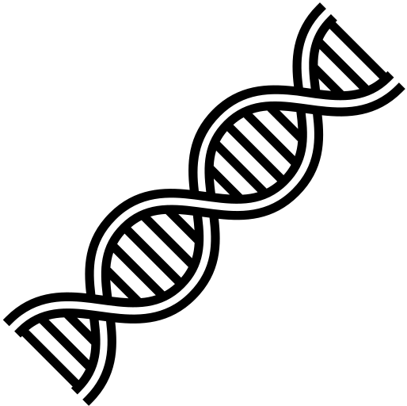
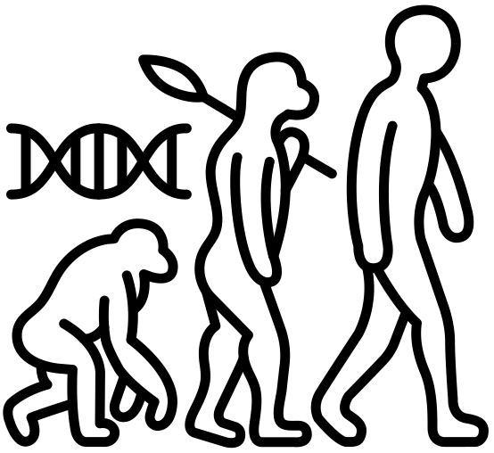
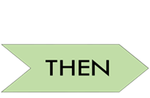
Idsall School
Year 13 A Level Biology Learning Journey
This way to Further Education, Training or Employment
Exam Preparation
Build a portfolio of revision material, to help remember content covered and commit key information to long term memory. You will be tested on all the content learned over the course of the 2 years in your final A-Level exams.
Preparation for Next Year
Exam Preparation
Build a portfolio of revision material, to help remember content covered and commit key information to long term memory. You will be tested on all the content learned over the course of the 2 years in your final A-Level exams.
A Level Exams
Summer Term 2
6.3.2 Populations and sustainability- There are many factors that determine the size of a population. For economic, social and ethical reasons ecosystems may need to be carefully managed. To support an increasing human population, we need to use biological resources in a sustainable way.
6.2.1 Cloning and biotechnology-Farmers and growers exploit “natural” vegetative propagation in the production of uniform crops. Artificial clones of plants and animals can now be produced. Biotechnology is the industrial use of living organisms (or parts of living organisms) to produce food, drugs or other product.
6.3.2 Populations and sustainability; 6.2.1 Cloning and biotechnology; Summer Term 1
6.1.3 Manipulating genomes-Genome sequencing gives information about the location of genes and provides evidence for the evolutionary links between organisms. Genetic engineering involves the manipulation of naturally occurring processes and enzymes. The capacity to manipulate genes has many potential benefits, but the implications of genetic techniques are subject to much public debate
6.3.1 Ecosystems- Organisms do not live in isolation but engage in complex interactions, not just with other organisms but also with their environment. The efficiency of biomass transfer limits the number of organisms that can exist in a particular ecosystem. Ecosystems are dynamic and tend towards some form of climax community.
6.1.3 Manipulating genomes; 6.3.1 Ecosystems
Spring Term 2
5.1.5 Plant & Animal responses- Plant responses to environmental changes are coordinated by hormones, some of which are important commercially. In animals, responding to changes in the environment is a complex and contnuous process, involving nervous, hormonal and muscular coordinaton.
6.1.1 Cellular Control - The way in which cells control metabolic reactons determines how organisms, grow, develop and functon.
6.1.2 Patterns of Inheritance- Isolating mechanisms can lead to the accumulation of different genetic information in populations, potentially leading to new species. Over a prolonged period of time, organisms have changed and some have become extinct. The theory of evolution explains these changes. Humans use artificial selection to produce similar changes in plants and animals.
5.1.5 Plant & Animal responses; 6.1.1 Cellular Control; 6.1.2 Patterns of inheritance
Spring Term 1
5.1.4 Hormonal Communication- The ways in which specific hormones bring about their effects are used to exemplify endocrine communication and control. Treatment of diabetes is used as an example of the use of medical technology in overcoming defects in hormonal control systems..
5.1.2 Excretion – In the module you will learn how the kidneys, liver and lungs are all involved in the removal of toxic products of metabolism from the blood and therefore contribute to homeostasis. The kidneys play a major role in the control of water potential of the blood. The liver also metabolises some toxins that are ingested
5.2.2 Respiration- The process whereby energy stored in complex organic molecules is transferred to ATP, ATP provides the immediate energy source for biological processes
5.1.4 Hormonal Communication; 5.1.2 excretion; 5.2.2 Respiration
Autumn Term 2
5.1.1 Communication & Homeostasis- We begin the fifth module of the A level course by learning about the type of stimuli living things need to be able to respond to, and why this is important in being able to maintain a constant internal environment. It is important that organisms. both plants and animals are able to respond to stimuli. This is achieved by communication within the body which may be chemical or electrical
5.1.3 Neuronal Communication- The stimulation of sensory receptors leads to the generation of an action potential in a neurone. Transmission between neurones takes place at synapses
5.2.1 Photosynthesis- In this module, the biochemical pathways of photosynthesis are considered, with an emphasis on the formation and use of ATP as the source of energy for biochemical processes and synthesis of biological molecules
5.1.1 Homeostasis; 5.1.3 Neuronal Communication; 5.2.1 Photosynthesis
Autumn Term 1
Year 12 Biology
You will enter Y13 having studied Foundations in Biology, Exchange and Transport, Biodiversity, Evolution and Disease.
You will also have acquired a variety of practical skills via the first year of your PAG module.
Start here

